Slide 1
Final
Presentation
By Misha Bablani

Slide 2
TABLE OF CONTENTS
01.
02.
03.
Introduction
About my project
Experience
04.
05.
06.
My Internship so far
Acknowledgements
Description
My experience
Introduce myself.
All about my project that I am going to make.
About how I am doing so far in the internship
The Description
Small vote of thanks for all who have
helped me.

Slide 3
01.
Introduction

Slide 4
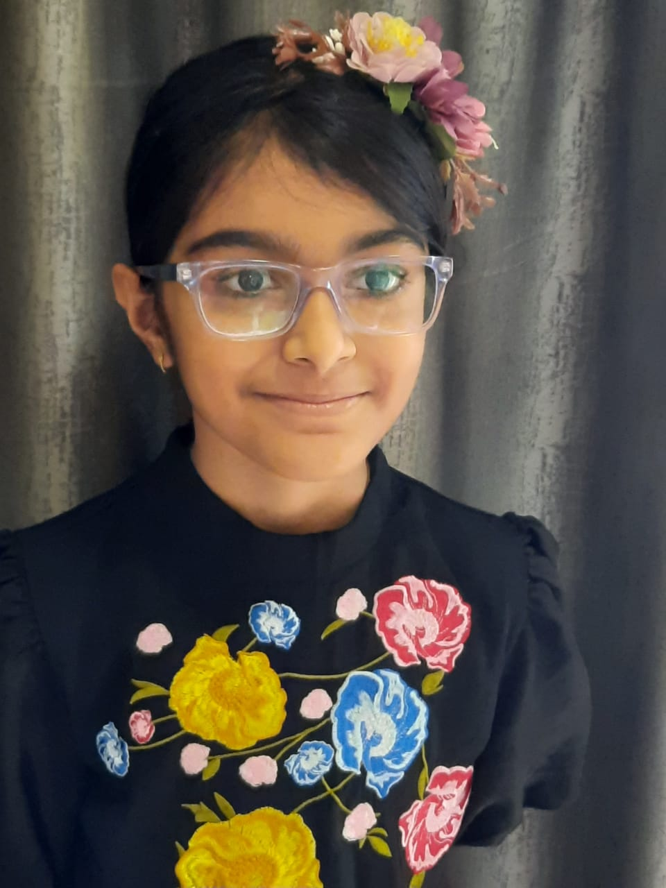
Introduction
Hi! I am Misha Bablani in grade5. I am having 3 years of experience in coding. Now I am in the AI wizard level 1. I am interested in learning more about coding.

Slide 5
My hobbies
Art
Acting
coding
Art is a calming activity for me.
Acting helps me act like new people.
Coding is like leaving all my troubles behind and jumping into virtual world.

Slide 6
02.
About my project

Slide 7
About the project
My project is a quiz generator.In this project I have to make a voice quiz generator App and I will use any educational theme which consist of three levels - Beginner Level, Intermediate Level and Advance Level..
Library:-
pip install SpeechRecognition
pip install tkinter
I have decided to make this project as I thought if any person wanted to test their skills in GK (General Knowledge) Questions they will get

Slide 8
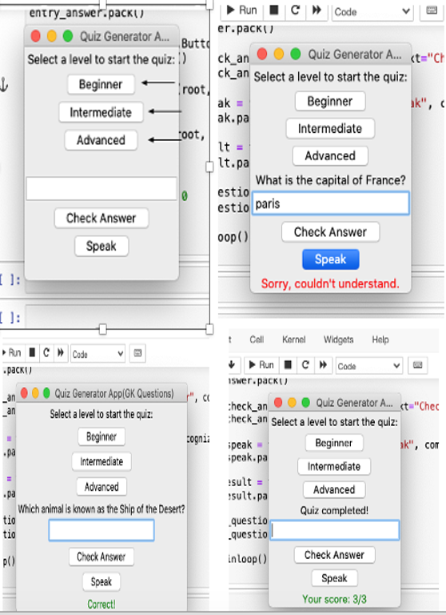

Slide 9
03.
Experience

Slide 10
My mentor is the most encouraging and most helpful teacher I have ever met in a online meeting. Whenever I do something wrong he tells me whats right and what's wrong. I like the clevered site as it is easy to use and the meeting still have little technical issues but it works great.

Slide 11
04.
My Internship so far

Slide 12
My Internship
It has been a great pleasure to be in a small group for oxford. It has been my dream to go or even work in oxford and here am I attending session with you. Thank you so much for the opportunity to become one of the few student's to go to oxford.

Slide 13
05.
Description

Slide 14
Description
This project is like a game where you answer questions to test your knowledge. You can choose how hard you want the questions to be: easy, medium, or hard.
Once you pick a level, questions will show up on the screen. You can type your answers or even talk and the computer will listen to what you say to see if it's right.
After each answer, the computer will tell you if you got it right or wrong. It keeps track of your score too. The game goes on until you've answered all the questions for that level.
There are buttons on the screen for choosing the level, typing your answers, checking if your answer is correct, and even a button for the computer to listen to what you say.

Slide 15
06.
Acknowledgements

Slide 16
Acknowledgements
I thank all who have helped me in this journey: My parents,my classmates,my mentors, my friends and specially my father

Slide 17
THANKS
Do you have any questions?
okmisha06@gmail.com

